Slide 1
Herbivory/Fan Fan Project
6.4.2020

Slide 2
Notes
One data point missing from July, Plot 5
Trees not repeated in May/July
5 Plots, 4 trees sampled from each
Response: Logit of proportion data
Missing leaf area + existing leaf area = total leaf area; missing/total = proportion (p)
Proportion logit transformed, smallest value used for 0s

Slide 3
Notes
“Arcsine is asinine” reference, logit is closer to normal

Slide 4
Final Model
lm3 <- lmer(logit2~Species* Month+ (1|Plot/Tree), data = herb)
summary(lm3)
plot(lm3)
AIC(lm3)
qqnorm(resid(lm3))
qqline(resid(lm3))

Slide 5
Summary
Linear mixed model fit by REML. t-tests use Satterthwaite's method ['lmerModLmerTest']
Formula: logit2 ~ Species * Month + (1 | Plot/Tree)
Data: herb
REML criterion at convergence: 929.6
Scaled residuals:
Min 1Q Median 3Q Max
-1.7809 -0.6859 -0.1438 0.7268 3.0061
Random effects:
Groups Name Variance Std.Dev.
Tree:Plot (Intercept) 0.004187 0.06471
Plot (Intercept) 0.021487 0.14658
Residual 1.043626 1.02158
Number of obs: 319, groups: Tree:Plot, 40; Plot, 5
Fixed effects:
Estimate Std. Error df t value Pr(>|t|)
(Intercept) -2.71962 0.17671 28.11503 -15.391 3.16e-15 ***
Speciesmandshurica -0.10796 0.23207 28.03798 -0.465 0.645391
Speciesnigra 0.06768 0.23352 28.68217 0.290 0.774046
Speciespennsylvanica -0.48243 0.23207 28.03798 -2.079 0.046900 *
MonthMay -0.97834 0.23207 28.03798 -4.216 0.000235 ***
Speciesmandshurica:MonthMay 0.03374 0.32820 28.03798 0.103 0.918860
Speciesnigra:MonthMay -0.12413 0.32922 28.35943 -0.377 0.708955
Speciespennsylvanica:MonthMay 0.48927 0.32820 28.03798 1.491 0.147186
---
Signif. codes: 0 ‘***’ 0.001 ‘**’ 0.01 ‘*’ 0.05 ‘.’ 0.1 ‘ ’ 1
Correlation of Fixed Effects:
(Intr) Spcsmn Spcsng Spcspn MnthMy Spcsm:MM Spcsn:MM
Spcsmndshrc -0.657
Speciesnigr -0.653 0.497
Spcspnnsylv -0.657 0.500 0.497
MonthMay -0.657 0.500 0.497 0.500
Spcsmnds:MM 0.464 -0.707 -0.351 -0.354 -0.707
Spcsngr:MnM 0.463 -0.352 -0.709 -0.352 -0.705 0.498
Spcspnns:MM 0.464 -0.354 -0.351 -0.707 -0.707 0.500 0.498

Slide 6
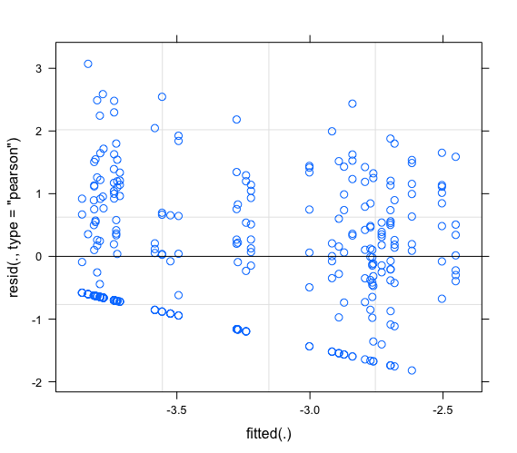

Slide 7
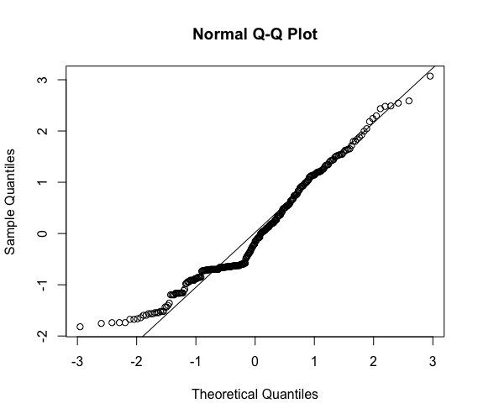

Slide 8
Contrasts w/o interaction
#contrasts
summary(glht(lm3, linfct = mcp(Species = "Tukey")))
summary(glht(lm3, linfct = mcp(Month = "Tukey")))
K5 <- glht(lm3, linfct = mcp(Species = "Tukey"))$linfct
K6 <- glht(lm3, linfct = mcp(Month = "Tukey"))$linfct
summary(glht(lm3, linfct = rbind(K5, K6)))

Slide 9
Contrasts
> summary(glht(lm3, linfct = rbind(K5, K6)))
Simultaneous Tests for General Linear Hypotheses
Fit: lmer(formula = logit2 ~ Species * Month + (1 | Plot/Tree), data = herb)
Linear Hypotheses:
Estimate Std. Error z value Pr(>|z|)
mandshurica - hybrid == 0 -0.10796 0.23207 -0.465 0.9854
nigra - hybrid == 0 0.06768 0.23352 0.290 0.9976
pennsylvanica - hybrid == 0 -0.48243 0.23207 -2.079 0.1831
nigra - mandshurica == 0 0.17563 0.23352 0.752 0.9206
pennsylvanica - mandshurica == 0 -0.37447 0.23207 -1.614 0.4177
pennsylvanica - nigra == 0 -0.55011 0.23352 -2.356 0.0988 .
May - July == 0 -0.97834 0.23207 -4.216 <0.001 ***
---
Signif. codes: 0 ‘***’ 0.001 ‘**’ 0.01 ‘*’ 0.05 ‘.’ 0.1 ‘ ’ 1
(Adjusted p values reported -- single-step method)

Slide 10
Emmeans: w/ interaction
> lsmeans(lm3, pairwise~Month*Species, adjust="tukey")
$lsmeans
Month Species lsmean SE df lower.CL upper.CL
July hybrid -2.72 0.177 28.1 -3.08 -2.36
May hybrid -3.70 0.177 28.1 -4.06 -3.34
July mandshurica -2.83 0.177 28.1 -3.19 -2.47
May mandshurica -3.77 0.177 28.1 -4.13 -3.41
July nigra -2.65 0.179 29.3 -3.02 -2.29
May nigra -3.75 0.177 28.1 -4.12 -3.39
July pennsylvanica -3.20 0.177 28.1 -3.56 -2.84
May pennsylvanica -3.69 0.177 28.1 -4.05 -3.33
Degrees-of-freedom method: kenward-roger
Confidence level used: 0.95
$contrasts
contrast estimate SE df t.ratio p.value
July,hybrid - May,hybrid 0.97834 0.232 27.8 4.216 0.0051
July,hybrid - July,mandshurica 0.10796 0.232 27.8 0.465 0.9997
July,hybrid - May,mandshurica 1.05256 0.232 27.8 4.536 0.0022
July,hybrid - July,nigra -0.06768 0.234 28.5 -0.290 1.0000
July,hybrid - May,nigra 1.03480 0.232 27.8 4.459 0.0027
July,hybrid - July,pennsylvanica 0.48243 0.232 27.8 2.079 0.4517
July,hybrid - May,pennsylvanica 0.97151 0.232 27.8 4.186 0.0055
May,hybrid - July,mandshurica -0.87039 0.232 27.8 -3.751 0.0162
May,hybrid - May,mandshurica 0.07422 0.232 27.8 0.320 1.0000
May,hybrid - July,nigra -1.04602 0.234 28.5 -4.479 0.0025
May,hybrid - May,nigra 0.05645 0.232 27.8 0.243 1.0000
May,hybrid - July,pennsylvanica -0.49592 0.232 27.8 -2.137 0.4175
May,hybrid - May,pennsylvanica -0.00684 0.232 27.8 -0.029 1.0000
July,mandshurica - May,mandshurica 0.94461 0.232 27.8 4.070 0.0073
July,mandshurica - July,nigra -0.17563 0.234 28.5 -0.752 0.9943
July,mandshurica - May,nigra 0.92684 0.232 27.8 3.994 0.0089
July,mandshurica - July,pennsylvanica 0.37447 0.232 27.8 1.614 0.7385
July,mandshurica - May,pennsylvanica 0.86355 0.232 27.8 3.721 0.0174
May,mandshurica - July,nigra -1.12024 0.234 28.5 -4.797 0.0011
May,mandshurica - May,nigra -0.01777 0.232 27.8 -0.077 1.0000
May,mandshurica - July,pennsylvanica -0.57014 0.232 27.8 -2.457 0.2548
May,mandshurica - May,pennsylvanica -0.08106 0.232 27.8 -0.349 1.0000
July,nigra - May,nigra 1.10247 0.234 28.5 4.721 0.0013
July,nigra - July,pennsylvanica 0.55010 0.234 28.5 2.355 0.3004
July,nigra - May,pennsylvanica 1.03918 0.234 28.5 4.450 0.0027
May,nigra - July,pennsylvanica -0.55237 0.232 27.8 -2.380 0.2893
May,nigra - May,pennsylvanica -0.06329 0.232 27.8 -0.273 1.0000
July,pennsylvanica - May,pennsylvanica 0.48908 0.232 27.8 2.107 0.4347
P value adjustment: tukey method for comparing a family of 8 estimates

Slide 11
Emmeans: time
> lsmeans(lm3, pairwise~Month, adjust="tukey")
NOTE: Results may be misleading due to involvement in interactions
$lsmeans
Month lsmean SE df lower.CL upper.CL
July -2.85 0.105 8.10 -3.09 -2.61
May -3.73 0.105 8.04 -3.97 -3.49
Results are averaged over the levels of: Species
Degrees-of-freedom method: kenward-roger
Confidence level used: 0.95
$contrasts
contrast estimate SE df t.ratio p.value
July - May 0.879 0.116 28 7.560 <.0001
Results are averaged over the levels of: Species

Slide 12
Emmeans: species
> lsmeans(lm3, pairwise~Species, adjust="tukey")
NOTE: Results may be misleading due to involvement in interactions
$lsmeans
Species lsmean SE df lower.CL upper.CL
hybrid -3.21 0.133 17.2 -3.49 -2.93
mandshurica -3.30 0.133 17.2 -3.58 -3.02
nigra -3.20 0.134 17.5 -3.49 -2.92
pennsylvanica -3.45 0.133 17.2 -3.73 -3.17
Results are averaged over the levels of: Month
Degrees-of-freedom method: kenward-roger
Confidence level used: 0.95
$contrasts
contrast estimate SE df t.ratio p.value
hybrid - mandshurica 0.09109 0.164 27.8 0.555 0.9444
hybrid - nigra -0.00561 0.165 28.1 -0.034 1.0000
hybrid - pennsylvanica 0.23780 0.164 27.8 1.449 0.4807
mandshurica - nigra -0.09670 0.165 28.1 -0.587 0.9351
mandshurica - pennsylvanica 0.14671 0.164 27.8 0.894 0.8080
nigra - pennsylvanica 0.24341 0.165 28.1 1.479 0.4633
Results are averaged over the levels of: Month
P value adjustment: tukey method for comparing a family of 4 estimates

